Slide 1
Building Tools for Community
Science Datasets to Model Bird
Populations and Highly Pathogenic
Avian Influenza in Aotearoa New
Zealand
Richard Littauer
Kris Bubendorfer; Markus Luczak-Roesch

Slide 2
Pepeha
Ko Richard Graham Littauer tōku inga.
Nō Europe oku tupuna.
Nō te awa o Connecticut me Winooski au.
Kei te noho au ki Ōwhiro awa.

Slide 3
My goal
Improve our understanding of taonga manu and te taiao
Build tools and best practices for using community science data.
Model how HPAI will affect wild bird populations here in Aotearoa New Zealand

Slide 4
Research questions
How can current community science Best Practices be improved?
How can we harmonize taxonomies?
Can we predict HPAI effects on our taonga manu?

Slide 5
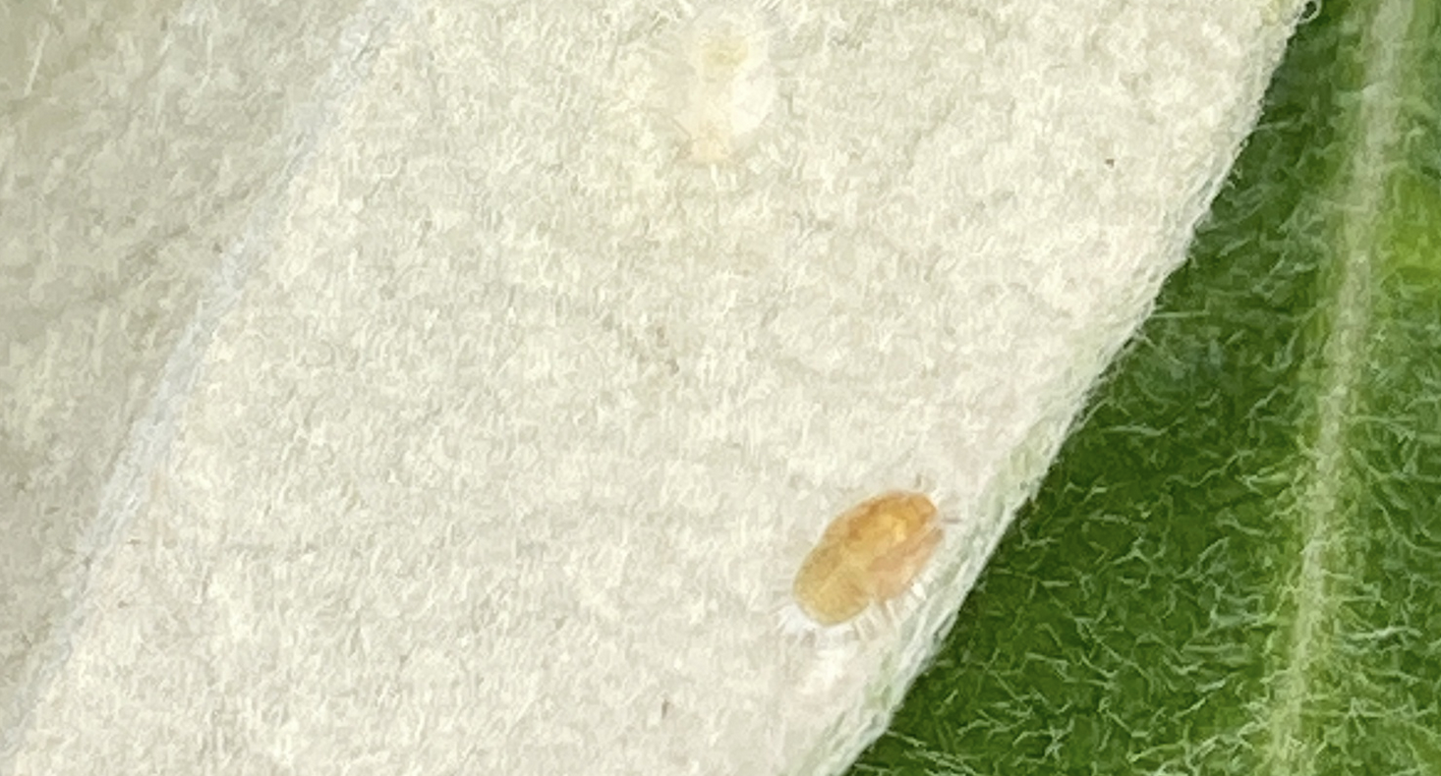
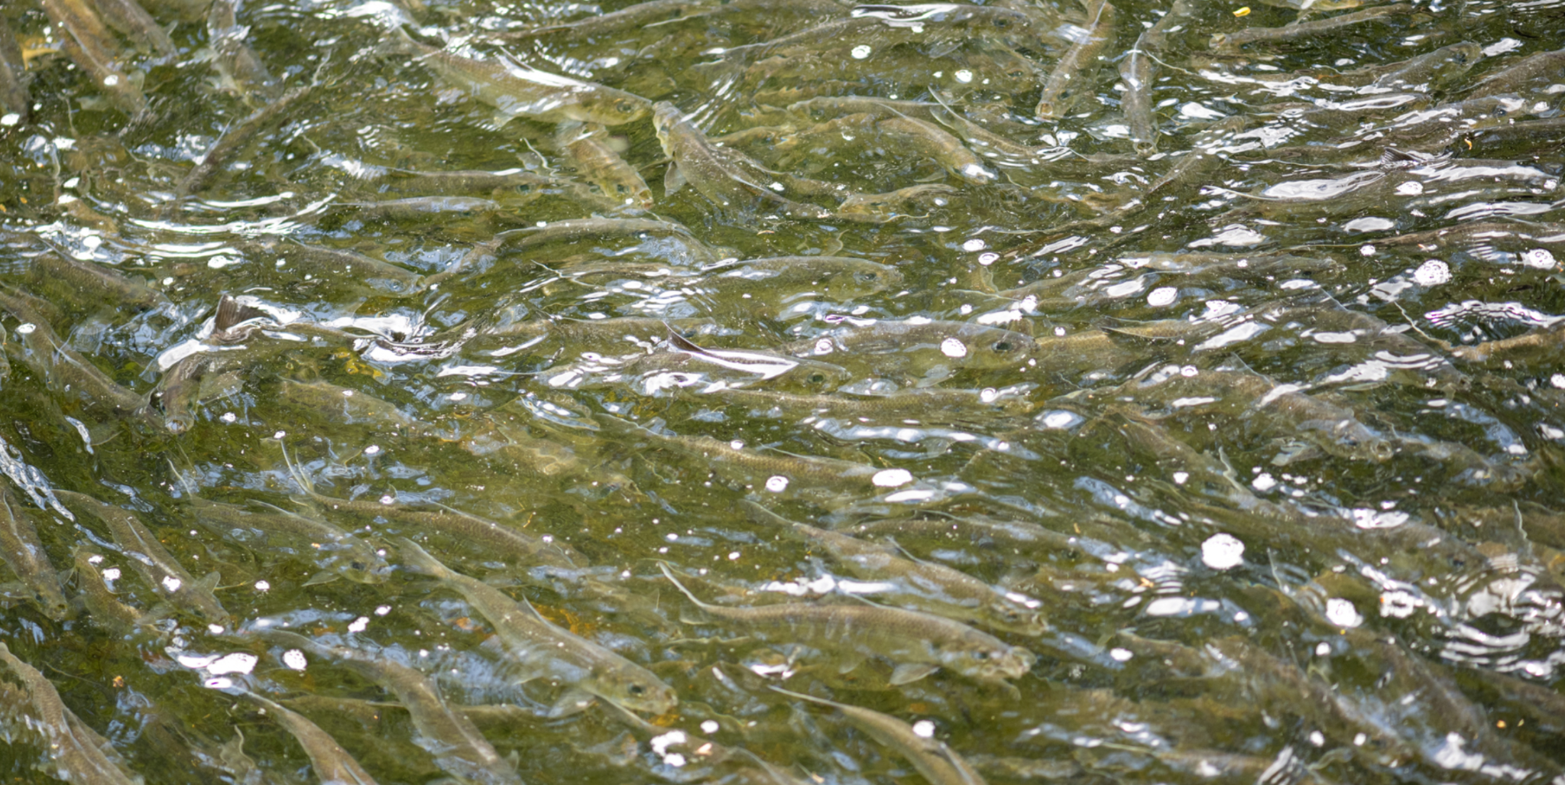
What is Community Science?
No exact definition
Amateur (non-professional) contributions
Also called citizen science
At scale
Useful for research
Skews to rich, educated, white people
Karo Felted Scale

Slide 6
What is Community Science?
eBird
1 billion observations
100 million checklists
1 million users
10,000 species of birds
iNaturalist
250 million observations
3 million users
500k species
Karo Felted Scale

Slide 7
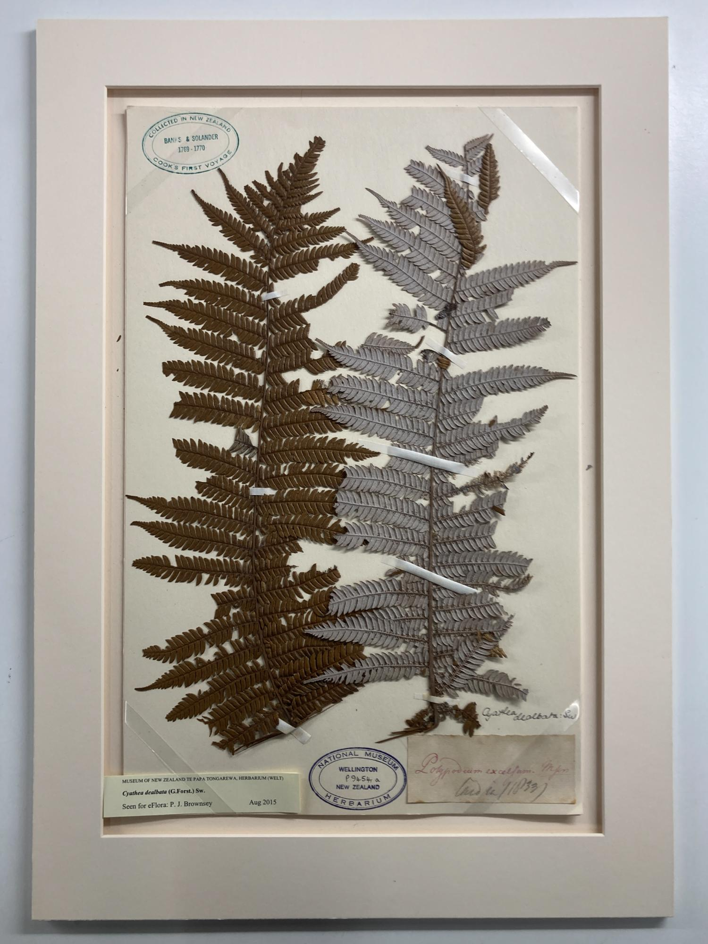
SCIENCE
Silver Fern, collected by Banks and Solander
C. 1769-1770, Aotearoa
Specimen in Te Papa
Ponga

Slide 8
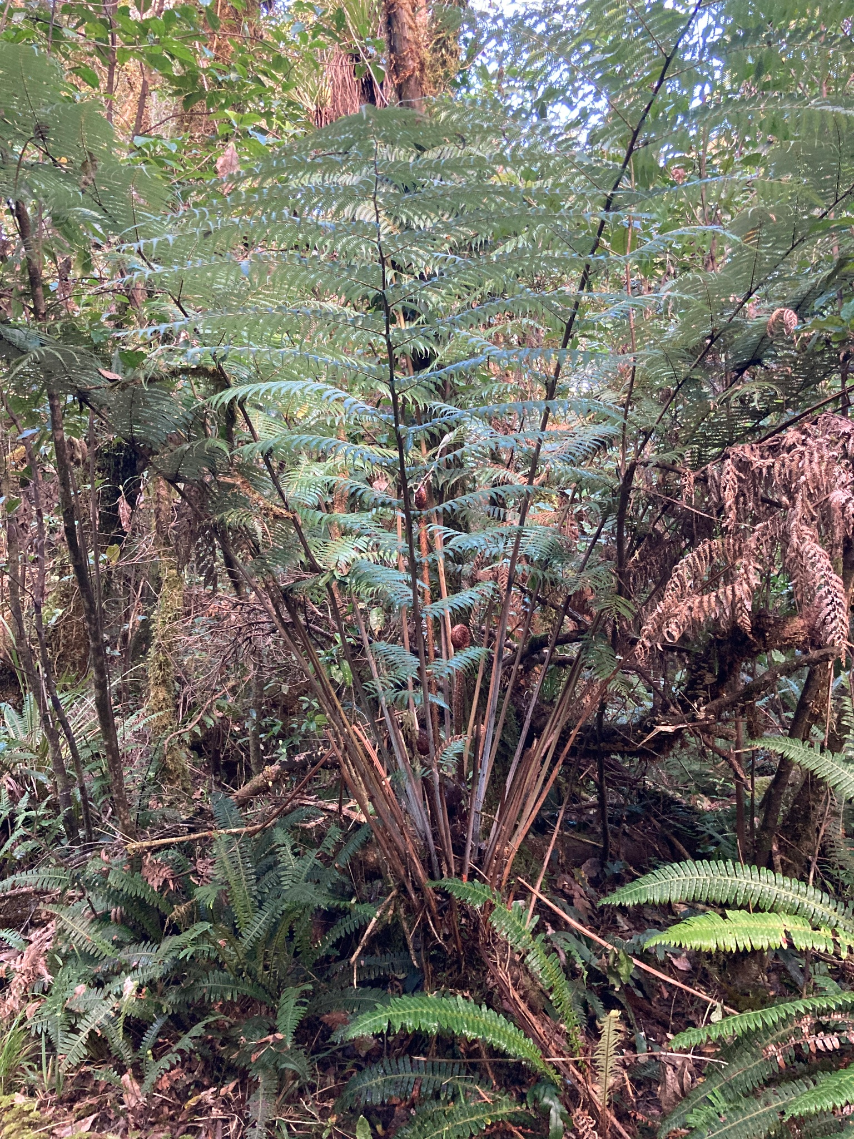
SCIENCE
Silver Fern, photographed by Littauer
Nov 14, 2022, Ohakune
https://www.inaturalist.org/observations/141999533
Ponga

Slide 9
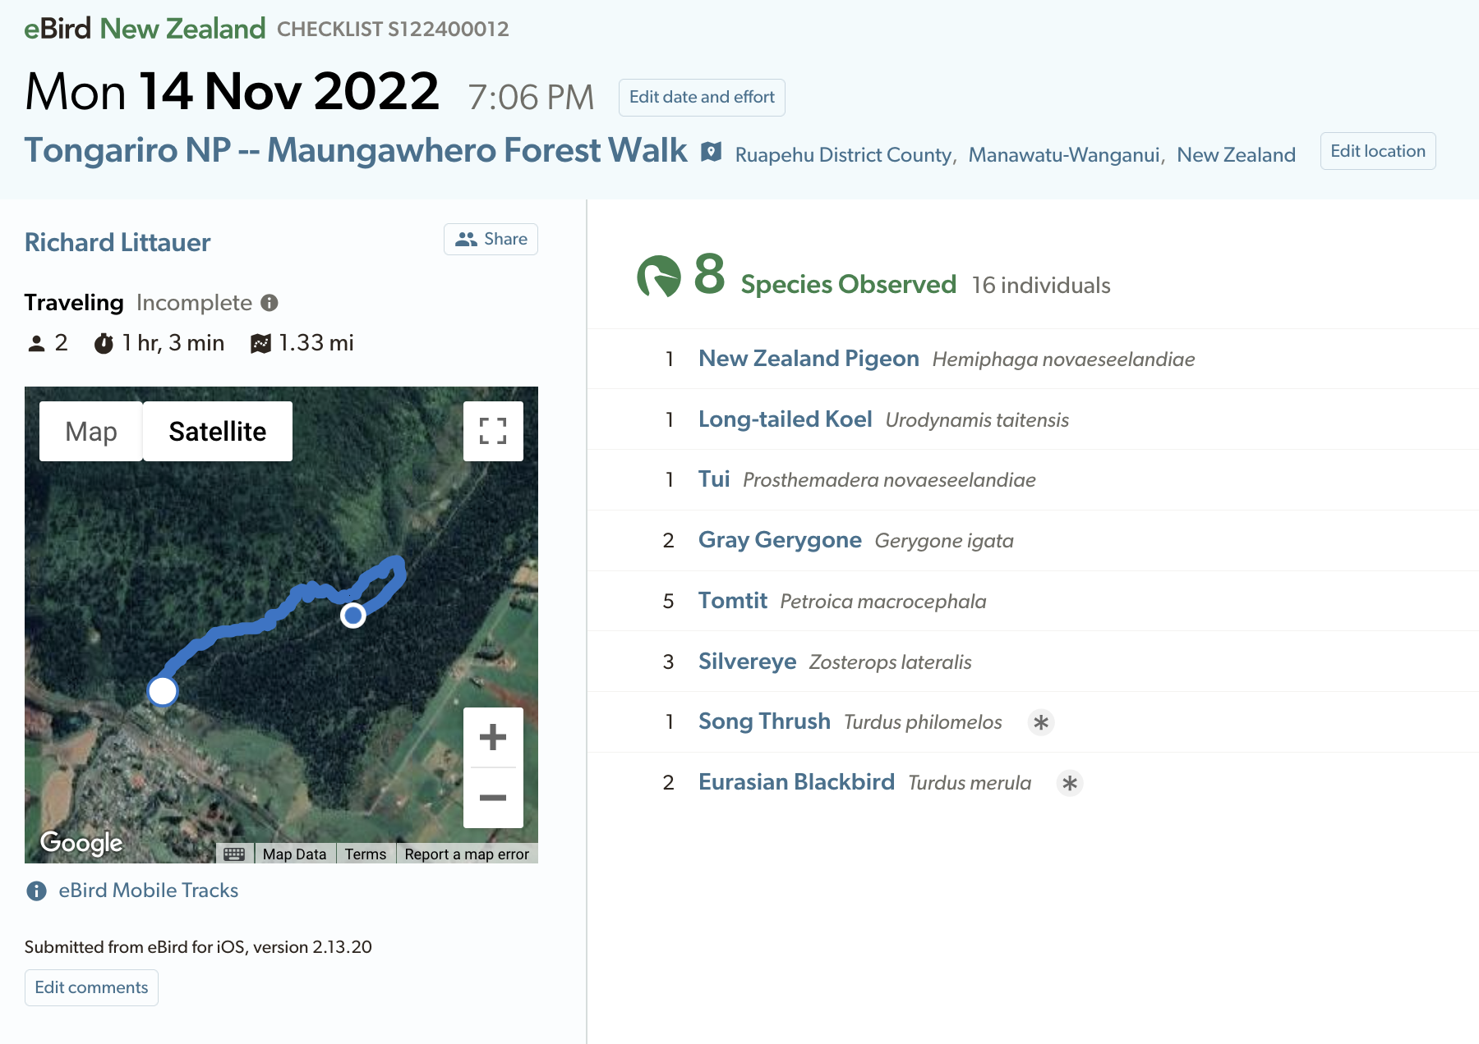
SCIENCE

Slide 10
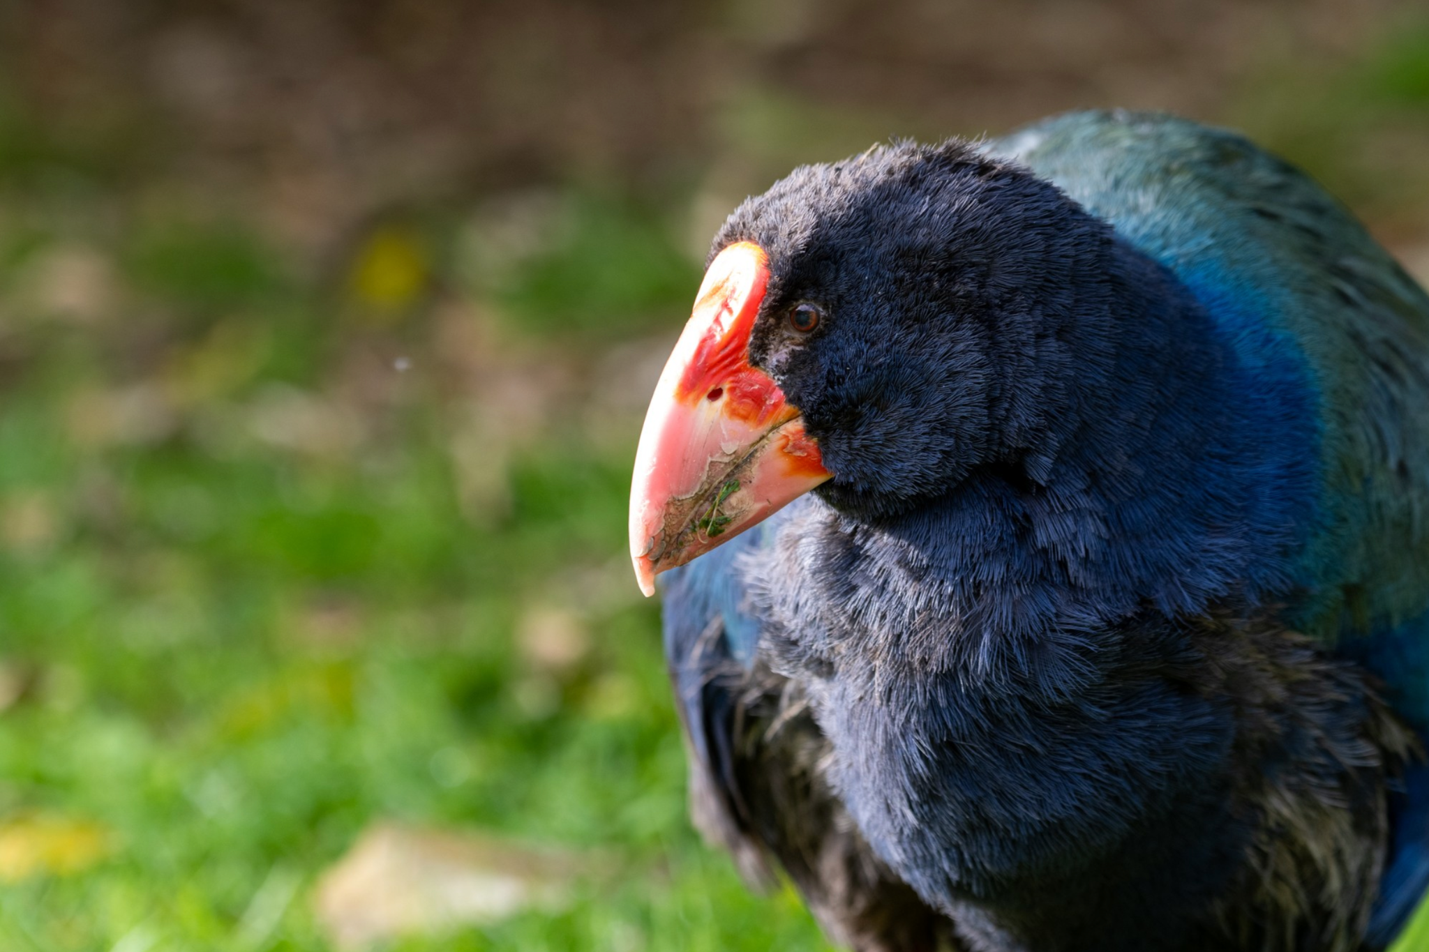
eBird
Birds.
Different protocols for birding
Audio and photo uploads
For science.
Takahē

Slide 11
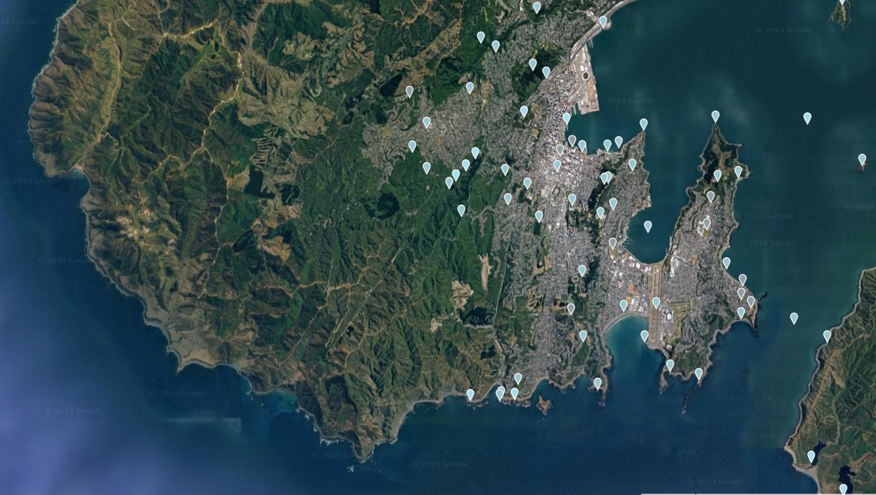
eBird
Regions
Hotspots
Te Whanga-nui-a-Tara

Slide 12
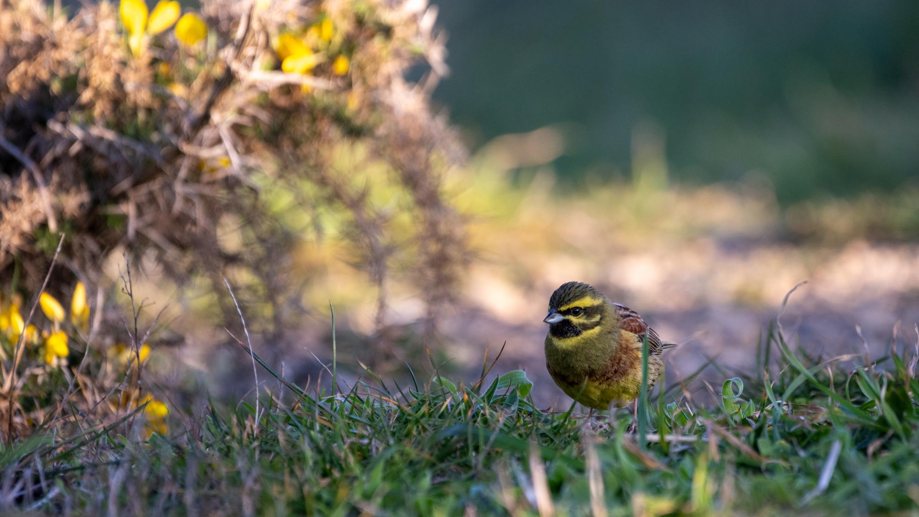
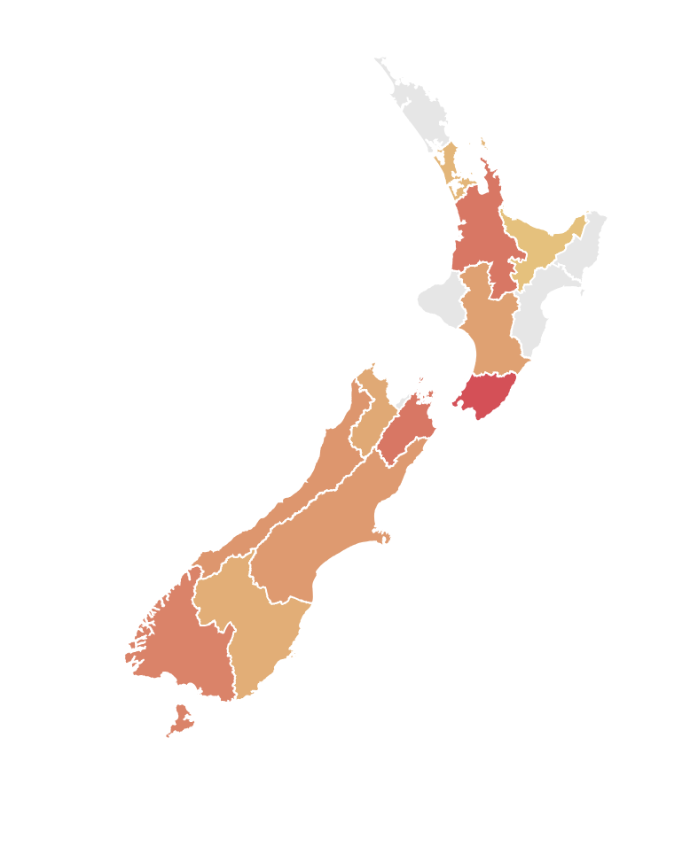
eBird
Users
Alerts
Cirl Bunting

Slide 13
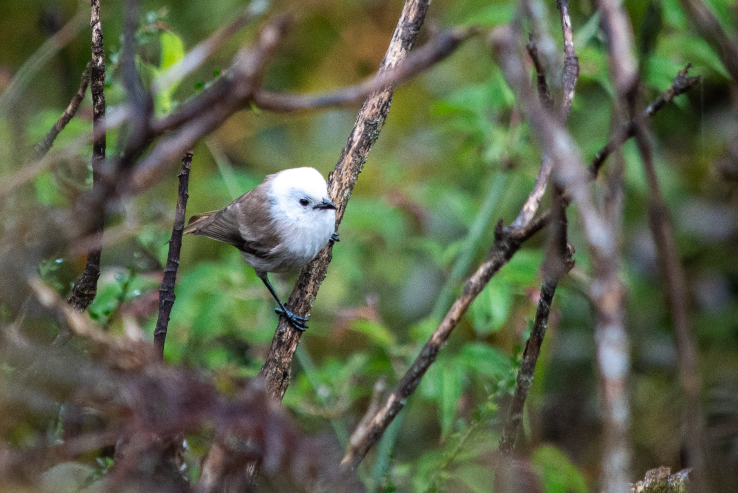
eBird
Reviewers
Pōpokotea

Slide 14
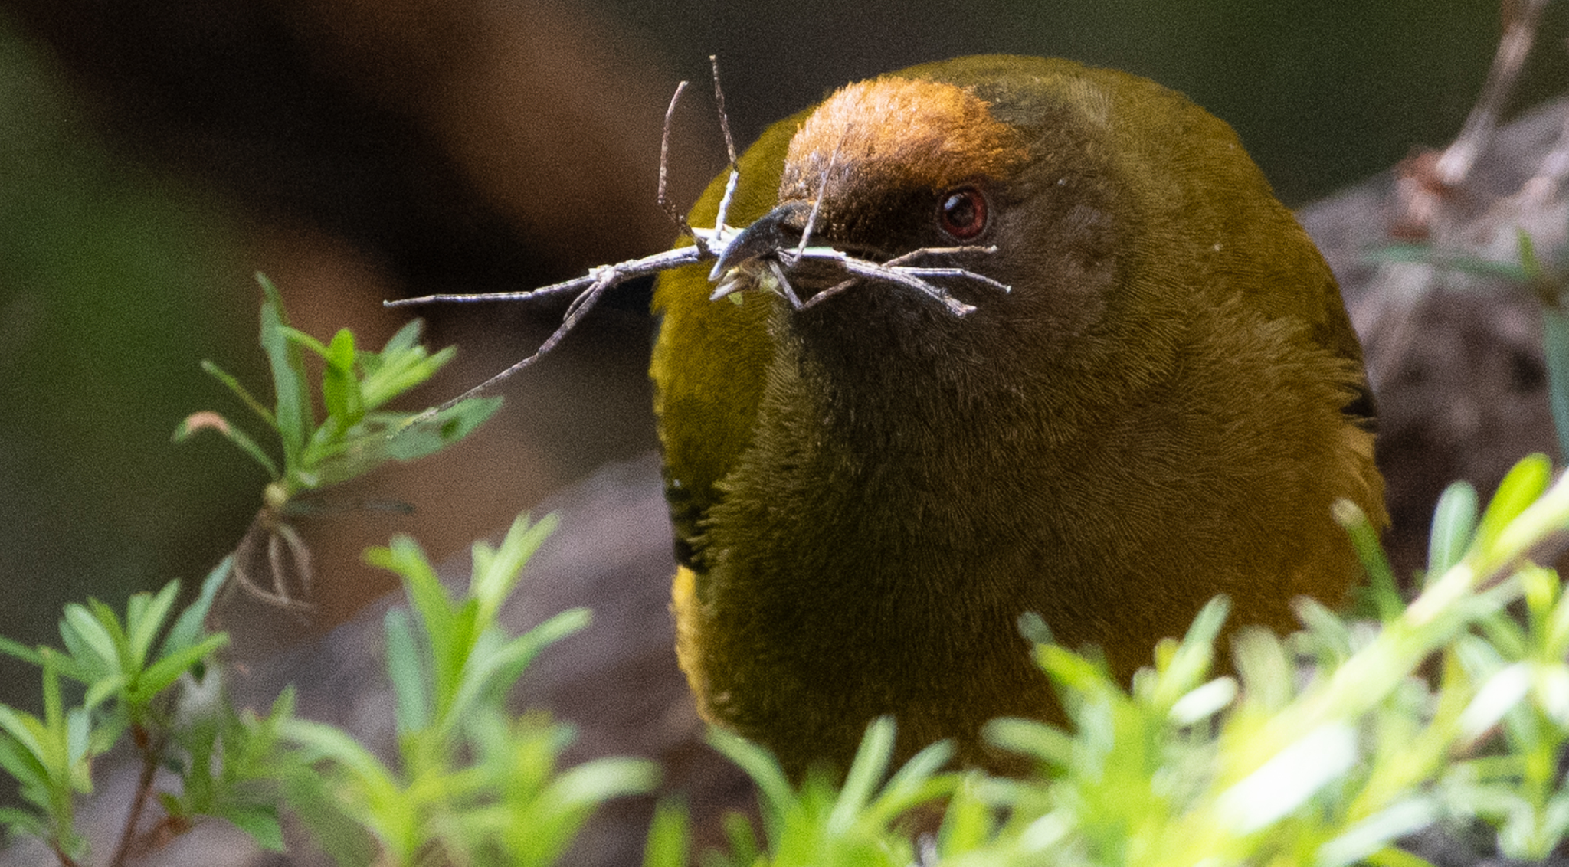
iNaturalist
All momo
Photos or audio
"Research grade"
Comments
Korimako, Manuka, & Rō

Slide 15
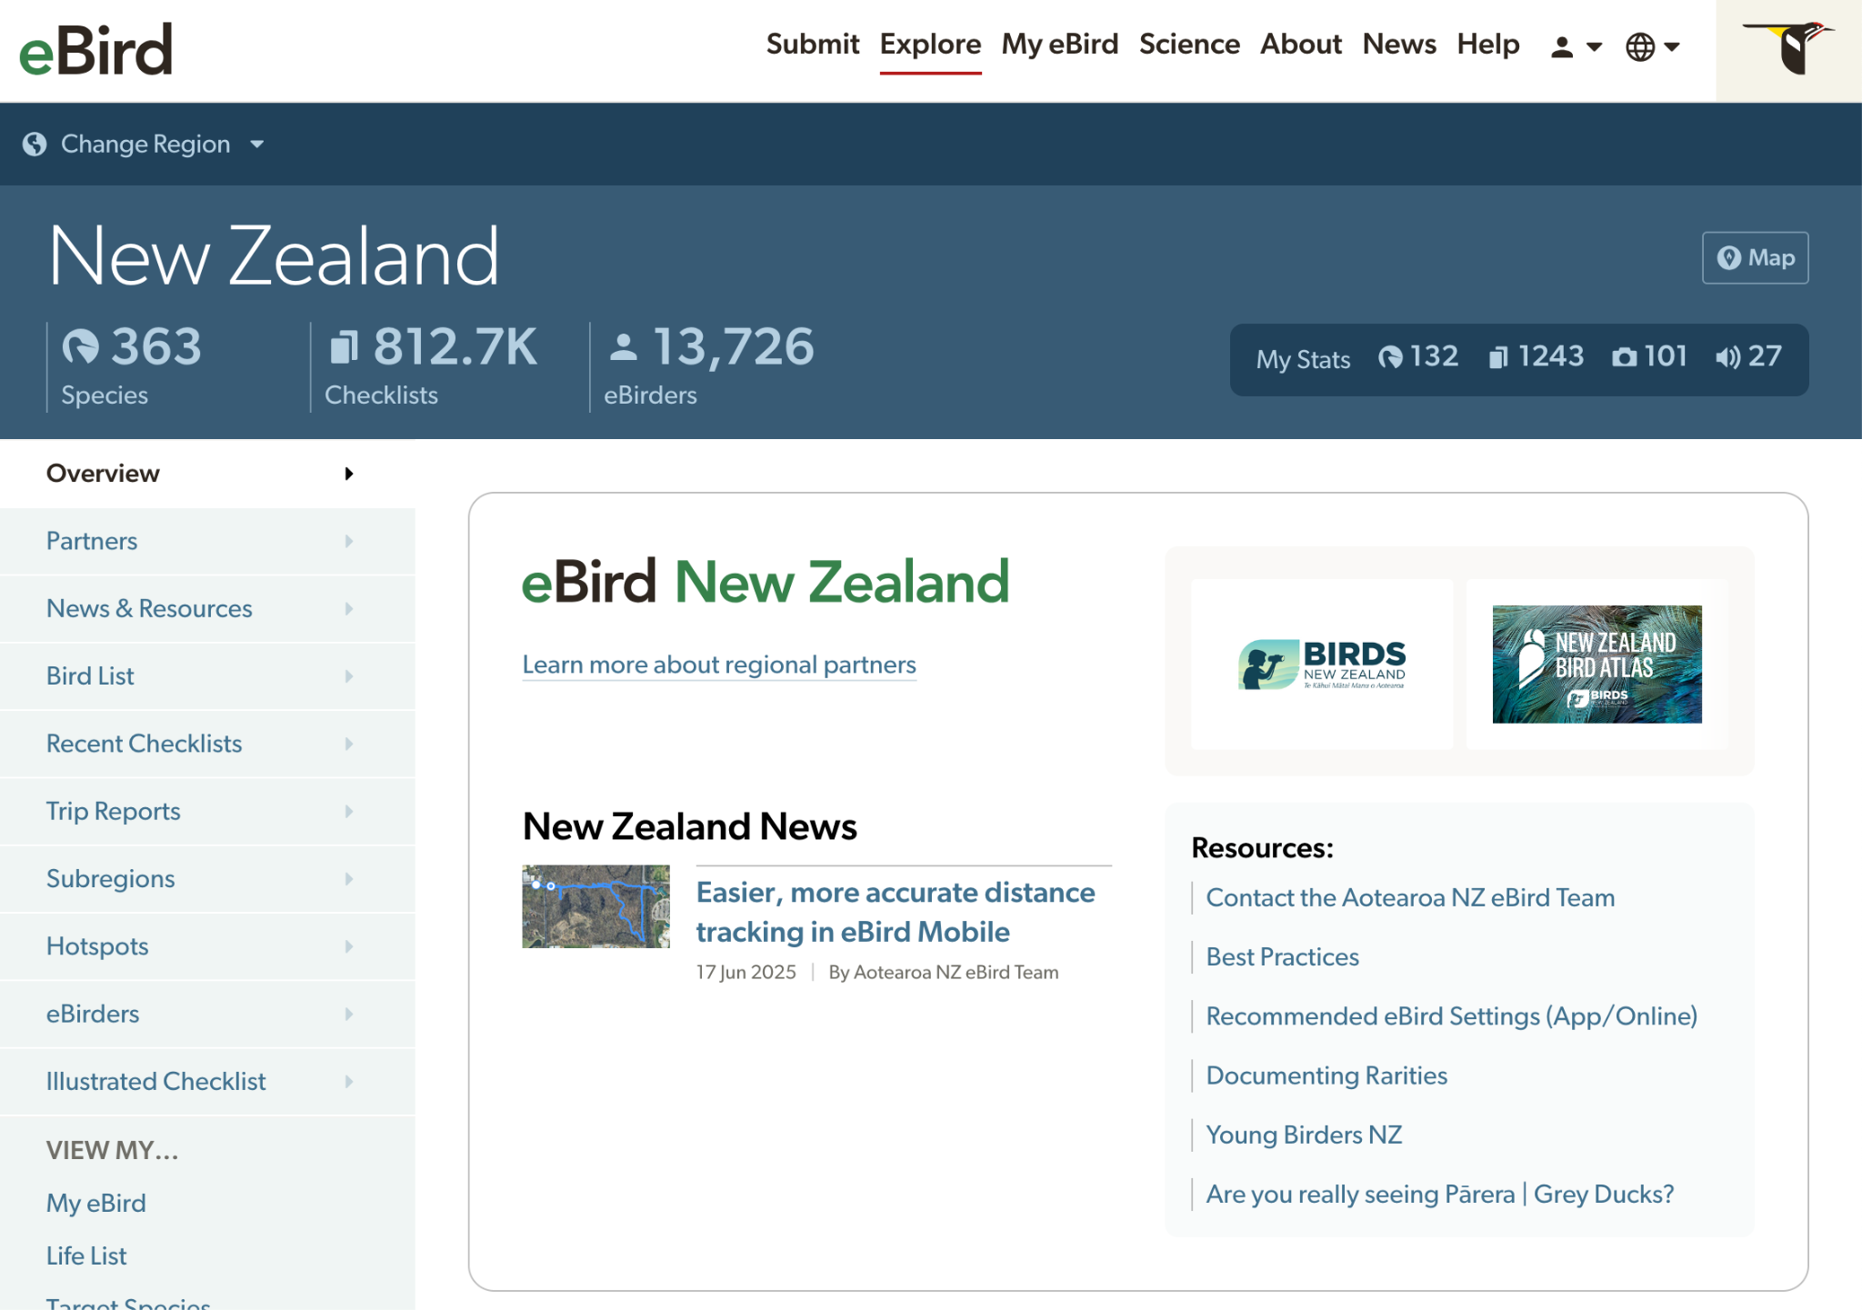

Slide 16
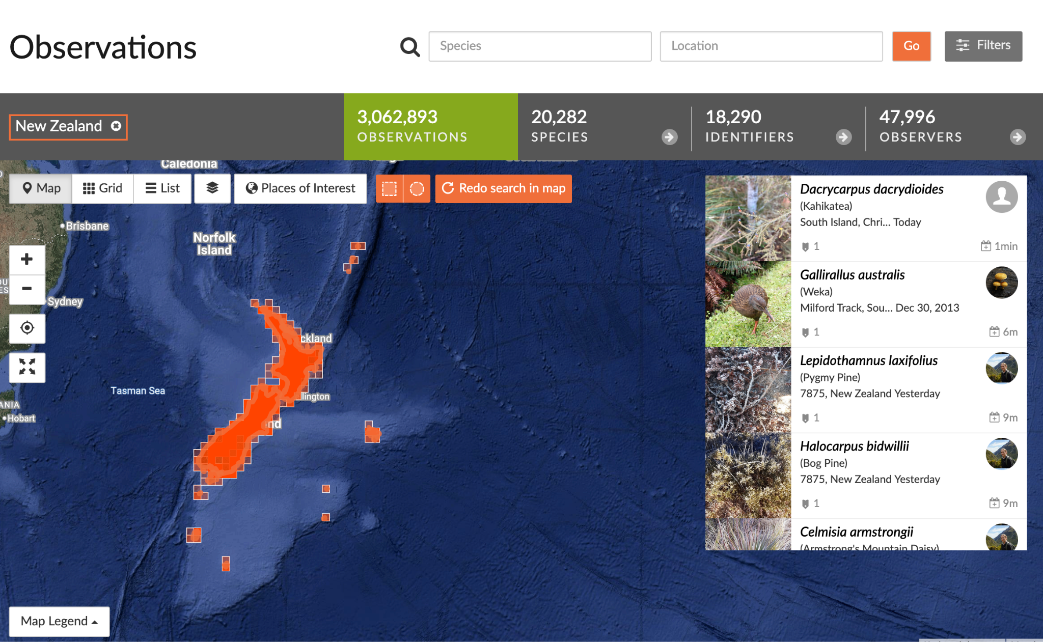

Slide 17
The problem
Protocols not standardized between platforms
Skill varies wildly
Vetting process different per platform
Bias in many areas:
Bigger birds are easier to see
Birds near human habitation are easier to count
People mainly bird on the weekends or in Zealandia
And, generally, few best practices exist for cleaning data

Slide 18
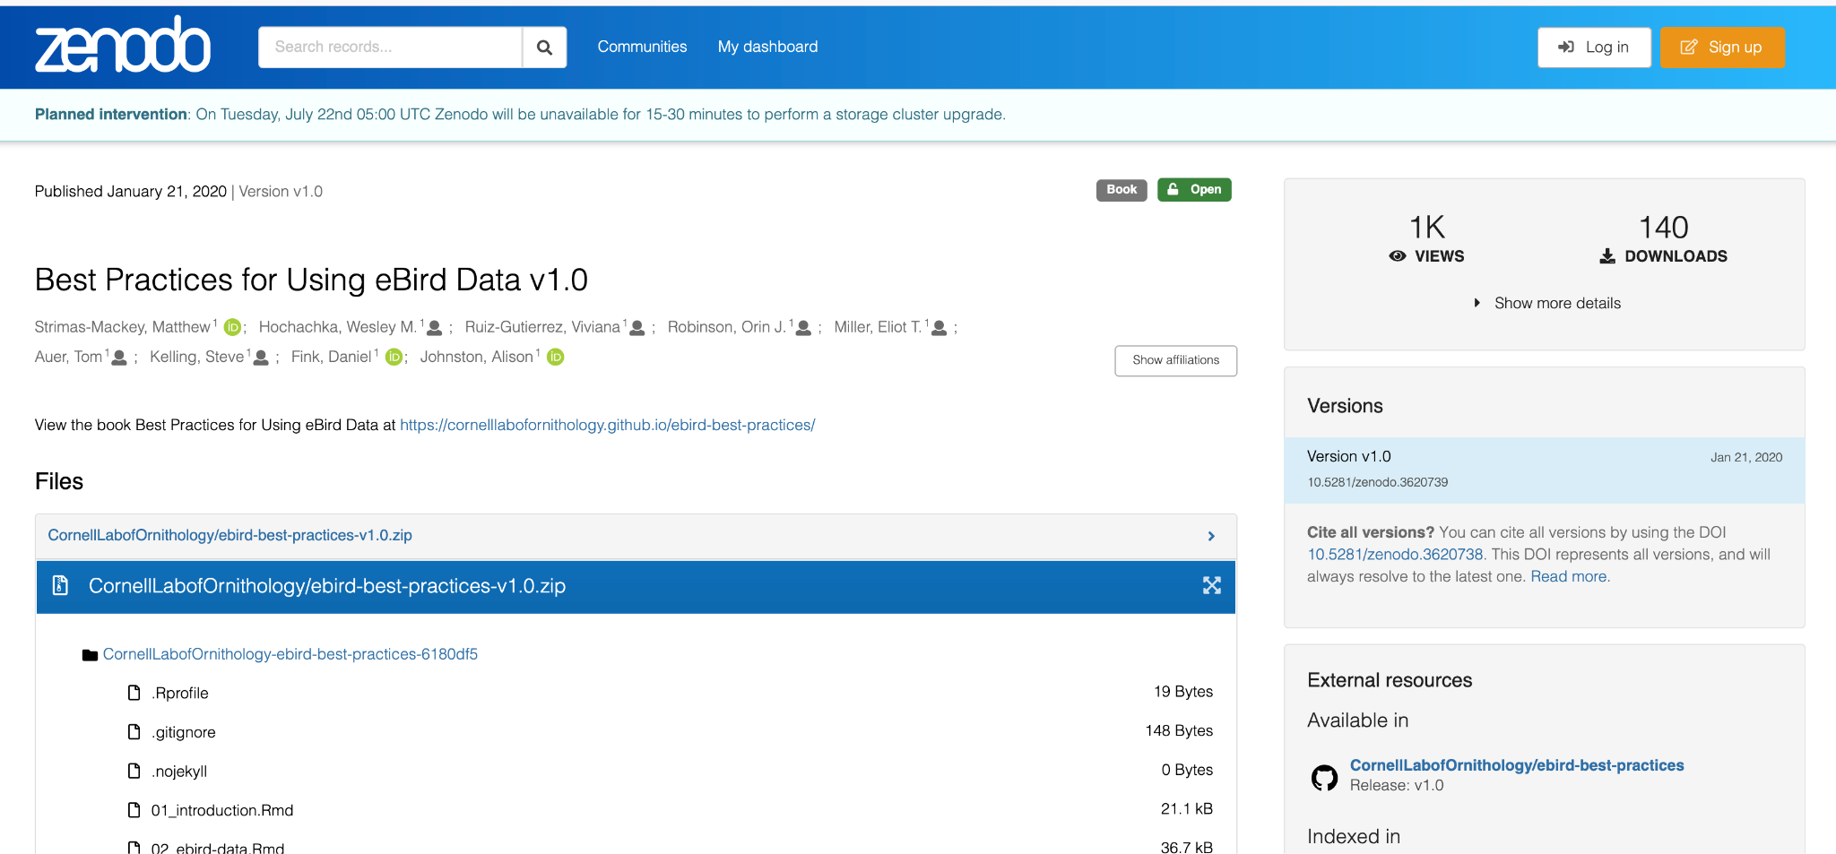
The problem

Slide 19
The problem
eBird best practices aren't immediately transferable to iNaturalist
There's nothing related to seabird data
Reviewer effort isn't standardized
Cleaning can be species or location specific
There's no automatic tool for comparing taxonomies across datasets

Slide 20
Use Case
Highly pathogenic avian influenza (bird flu)
Has killed millions of birds in the rest of the world
Particularly decimates seabird colonies
Hasn't arrived in Oceania yet
… Can we model it?

Slide 21
Use Case: HPAI in NZ
Vectors: Brown Skua, Kelp Gull, Giant Petrels, Snowy Sheathbills, Wandering Albatross
Probable entry point: the Subantarctic Island of New Zealand.
Spread: Seabirds > ducks & land birds & seals > poultry

Slide 22
Use Case: HPAI in NZ
Show what bird flu has done elsewhere
Import and harmonize multiple community science datasets
Extrapolate what it might do here
Document what issues we find during that process
Work on those.

Slide 23


Slide 24
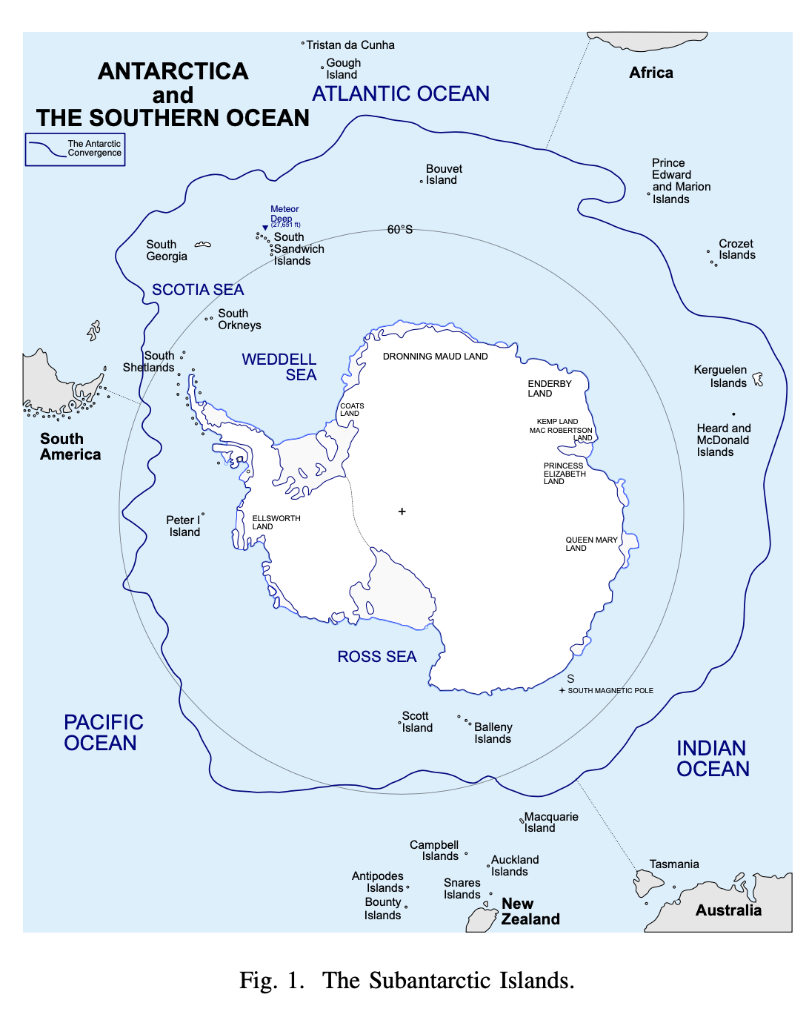
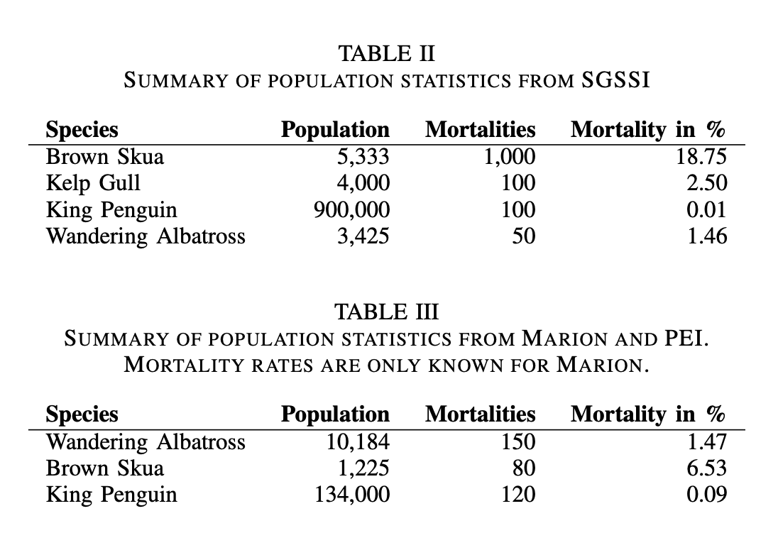
Novel dataset

Slide 25
Community science datasets
eBird (API, regions)
iNaturalist (Online interface)
GBIF
API; 3b records, 100k datasets
Royal Naval Birdwatching Society (RNBWS)
Entire db, 30k records
At-Sea Observations of Seabirds 1969 to 1990, Tasman Sea, New Zealand and Australian waters (ASObs)
Entire db, 50k records

Slide 26
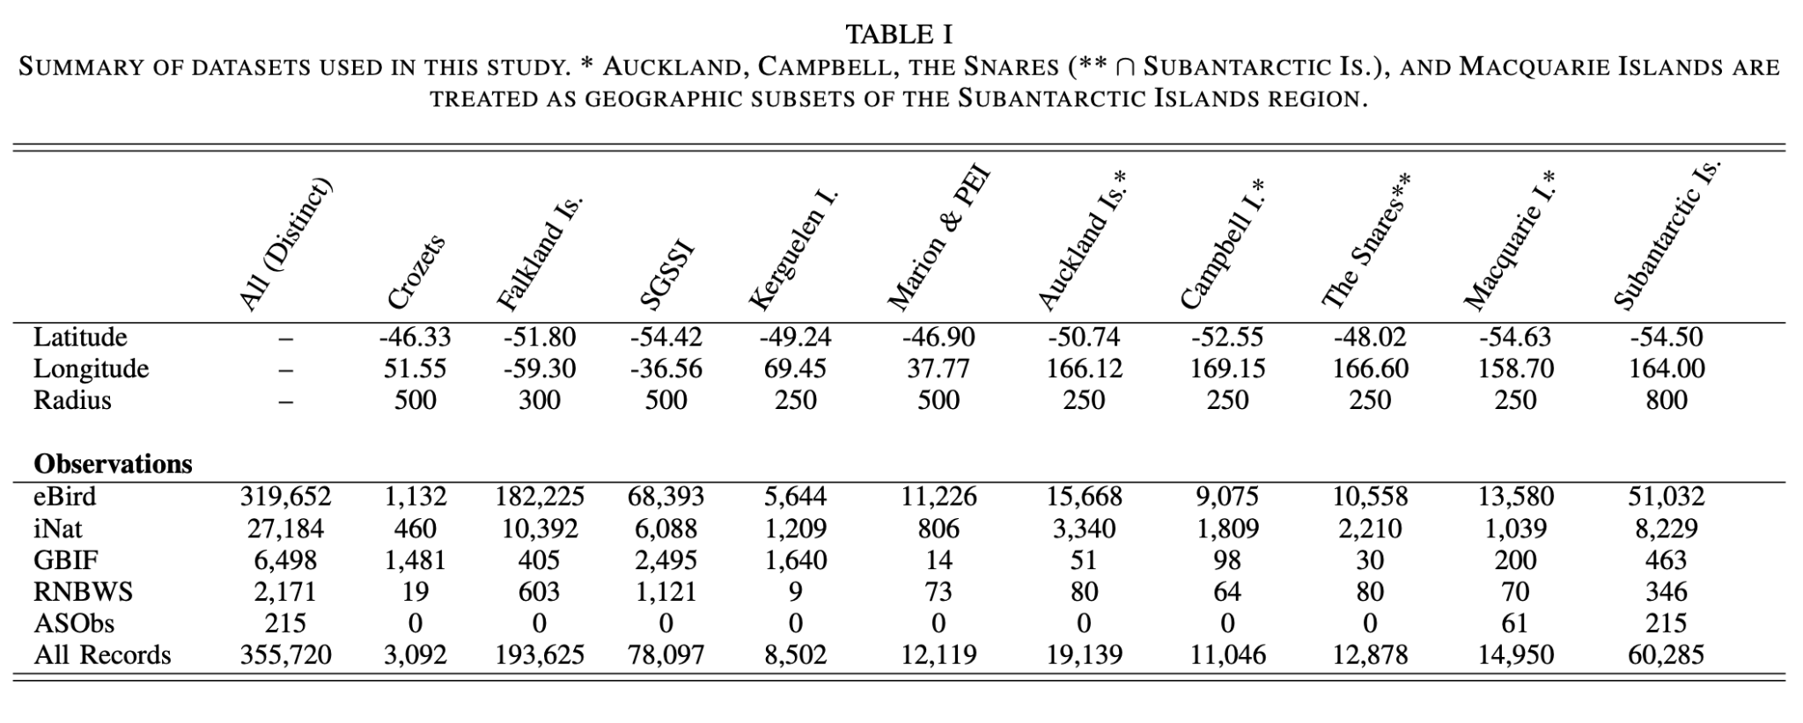
Community science datasets

Slide 27
Pipeline
Download
Clean
OpenRefine
Python
Normalize scientific names
Remove extraneous data
GIS filtering
Reproject, filter by area
Taxonomic reconciliation
Filter to only target species
Get population metrics from literature

Slide 28
Model
Given a known population and mortality metrics in South Georgia or Marion, and given an assumed similar observation frequency in community science data, use that frequency to project population sizes and mortality rates in the Subantarctic Islands of New Zealand.
If we have population sizes for SINZ, use those instead.

Slide 29
Model 1 - eBird Only
Brown Skua:
Known population of 500-1000 pairs
Predicted population of 3545
Predicted mortality of 326 (16.3%)
Other birds: Minimal effect
King Penguin: Too small of a mortality rate to have any effect, population overestimation by 4x
Wandering Albatross: mortality rates of 325~ for SINZ
Black-browed Albatross: 400~ birds from a 40k population
Kelp Gull: On MacQuarrie, 150 birds, 4 deaths. SINZ: 3133 pop., 78 deaths.

Slide 30
Model 2 - eBird + iNaturalist
Brown Skua:
Slightly higher: 3,565 birds, 632 mortality rate
King Penguin:
Population estimates closer to reality on Crozets and Kerguelen
Albatrosses:
Extrapolated populations much worse (as high as 1.4m on Campbell)
Kelp Gull:
Almost identical numbers: 3106 pop., 78 deaths.

Slide 31
Model 3 - all of the datasets
Generally unrealistic results.
Some datasets too sparse (Kelp Gull, Skua, Penguin)
Wandering Albatross: 7.5k on SINZ, mortality rate of 1.46%
Black-browed Albatross: Overestimation of population by 10x

Slide 32
Discussion
Skua population projections - especially Model 2 - was similar to known surveys.
For known populations of birds, this system works well.
Time may be a factor: 2353 out of 3565 Skuas may die from HPAI, if Great Skua numbers are used.

Slide 33
Discussion
For other birds, better data or data cleaning may be needed.
ASObs and RNBWS are pelagic; eBird and iNat aren't.
Sparse data projects are not robust.
Biases should be accounted for:
Charismatic species
Island differences
At sea vs. at land
Species differences (lifespan of albatross vs. gulls; breeding differences…)

Slide 34
What's next?
Better data cleaning
Account for known errors in eBird (am/pm, traveling/stationary, etc).
Use automatic clustering tools for checklists
Compare across community science platforms
Integrate species-specific data into the cleaning process
Build a specific cleaning pipeline in R and Python

Slide 35
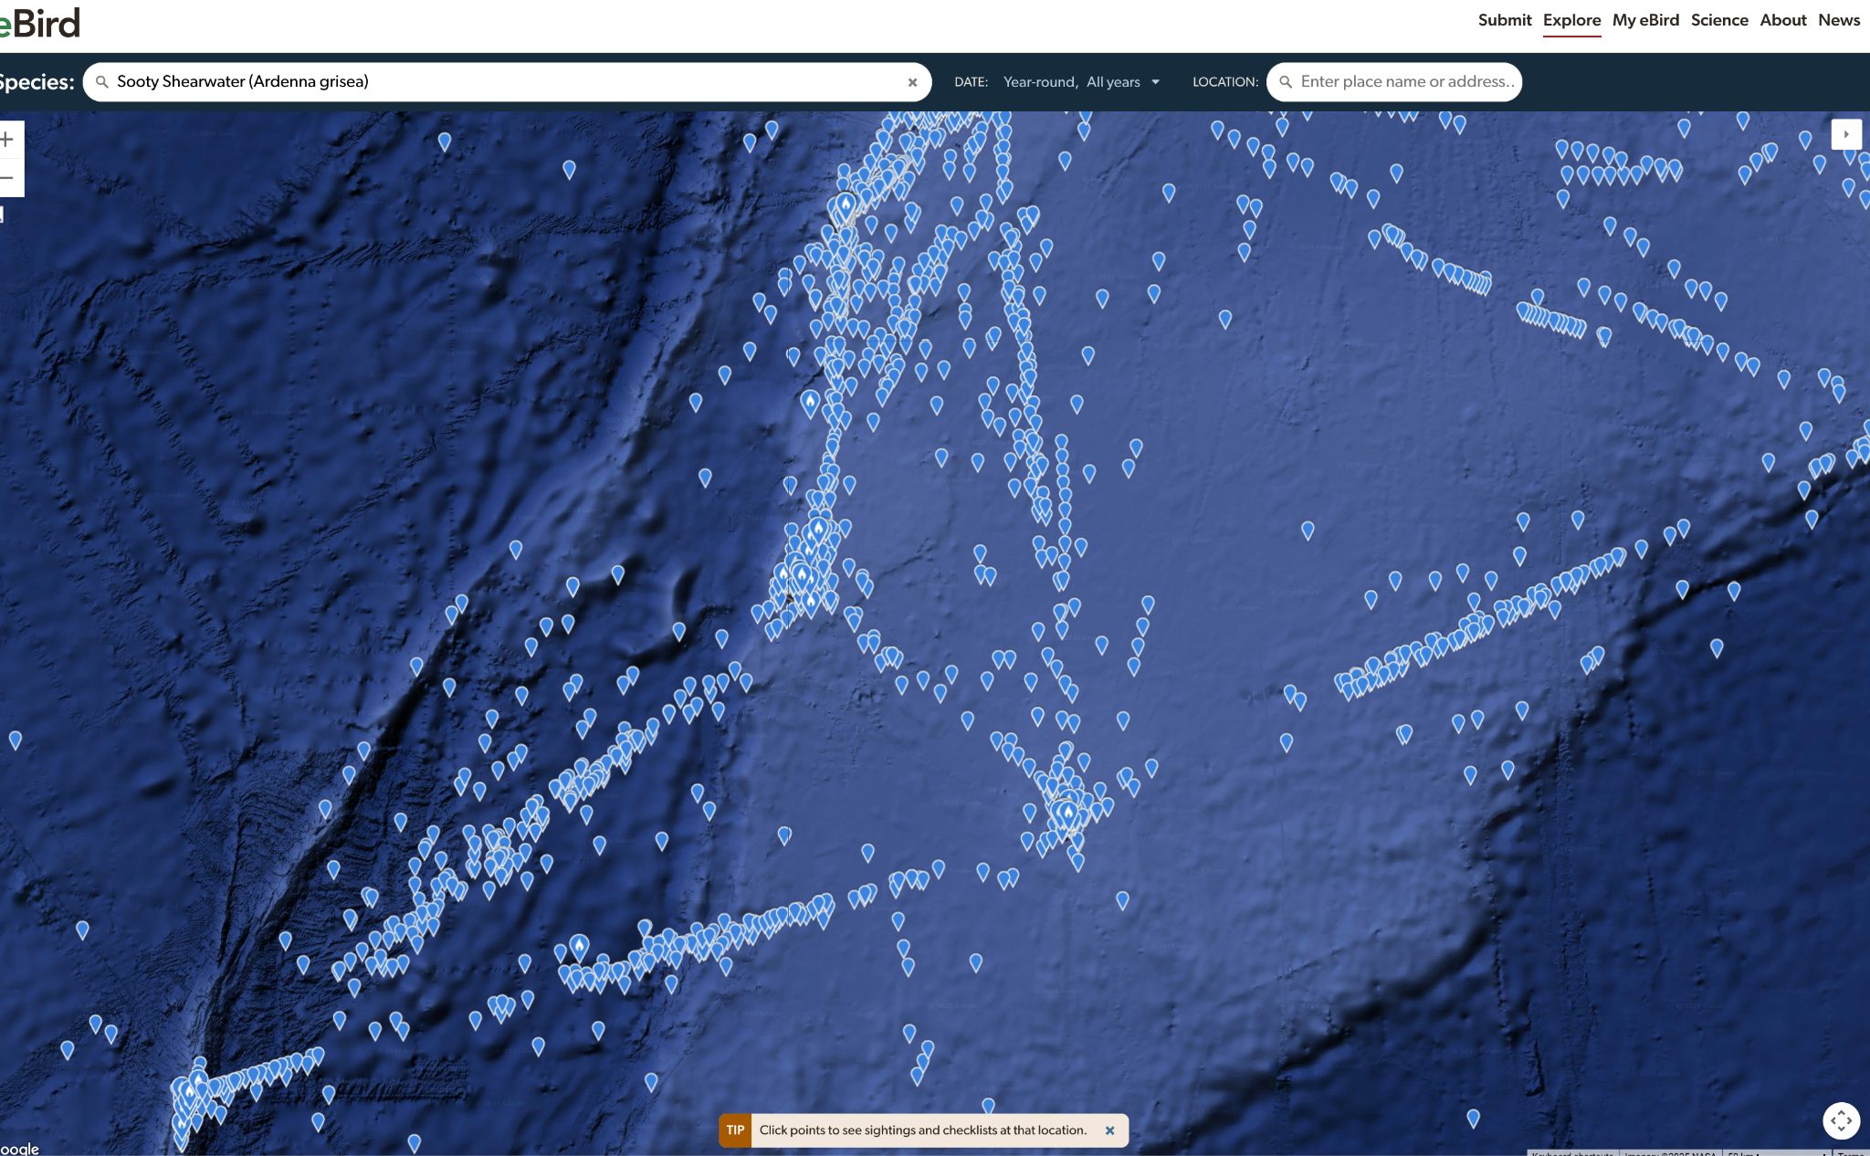
What's next?
Naval data
Point-to-point counts for known shipping routes
Provide better buffer areas for islands and coasts
Compare frequencies throughout the year
Allow arbitrary polygon downloads from eBird
Look for Ashmole's Halo in community science data

Slide 36
What's next?
Taxonomic ontology reconciliation
Cleaning tool for dirty datasets (what names are missing?)
Comparison tool across taxonomies (NZ Birds Checklist vs. eBird)
Integrate with OpenRefine and Wikidata through Avibase IDs

Slide 37
What's next?
Quantitative metastudy on community science data usage
Focus on cleaning and data pipelines
Focus on iNaturalist and eBird within Aotearoa New Zealand
AFAIK: hasn't been done anywhere.

Slide 38
What's Next?
Include terrestrial species in an HPAI model
Integrate with the NZ Bird Atlas data

Slide 39
Immediate plan
See if this paper can be resubmitted elsewhere
Best practices for pelagic bird species using community science data
Taxonomic resolution for BirdsNZ datasets and AviList
Publish on RNBWS, ASObs, and Beach Patrol Scheme data

Slide 40
Connections and activities so far
BirdsNZ Checklist Committee
Nomenclature Committee for AviList
eBird reviewer for Wellington
Gave talk at BirdsNZ Conference in Auckland
Organizing Kiwi Python, on the board for Python New Zealand
MRSNZ: ECR for Royal Society Te Apārangi
2 grants from Wikimedia Aotearoa New Zealand
1 grant from Wellington Botanical Society
Collaboration with: RNBWS and BirdsNZ Beach Patrol Scheme
Connected with: Manaaki Whenua Landcare Research, AgResearch, NIWA, Te Papa, REANNZ, Genomics Aotearoa, National Library, and Pacific Seabirds

Slide 41
Papers in 2025
Richard Littauer (2025). Renaming a bill type for Tundra Swan (Cygnus columbianus). Wilson Journal of Ornithology, 1–3. https://doi.org/10.1080/15594491.2025.2498780
Richard Littauer (2025). Corrections for agreement in gender in Notonectidae (Hemiptera: Heteroptera) under Article 31 of the Code. Zootaxa 5618(2): 287-288. https://doi.org/10.11646/zootaxa.5618.2.8
Richard Littauer (2025). A nomenclatural issue related to Lopdells’ penguin Archaeospheniscus lopdelli. Notornis 72(1): 49–50. https://doi.org/10.63172/777144pbjhsf
Richard Littauer (2025). First revision of karoro Larus dominicanus antipodum (Bruch, 1853). Notornis 72(1): 51–53. https://doi.org/10.63172/093633lrrwbq
Richard Littauer (2025). Tristan Moorhen (Gallinula nesiotis), version 2.0. In G. M. Kirwan and N. D. Sly eds., Birds of the World. Cornell Lab of Ornithology, Ithaca, NY, USA. https://doi.org/10.2173/bow.trimoo2.02
Richard Littauer (2025). Corrections for grammatical agreement in Ophiodermatidae. Zootaxa 5569(2): 400-400. https://doi.org/10.11646/zootaxa.5569.2.11

Slide 42
Other work
4 papers in press (1 ornithological, three nomenclatural)
11 other papers in review.
Active member of SNAP; hosted two workshops
Instructor for the Carpentries

Slide 43
Questions?

